Slide 1
Introduction to Flask & Serving Data with APIs

Slide 2
Class Objectives
You will be able to use Flask to create and run a server
You will define endpoints using Flask's @app.route decorator
You will learn to extract query variable path values from GET requests
You will use variable paths to execute database queries on behalf of the client
You will learn to return JSONified query results from API endpoints

Slide 3
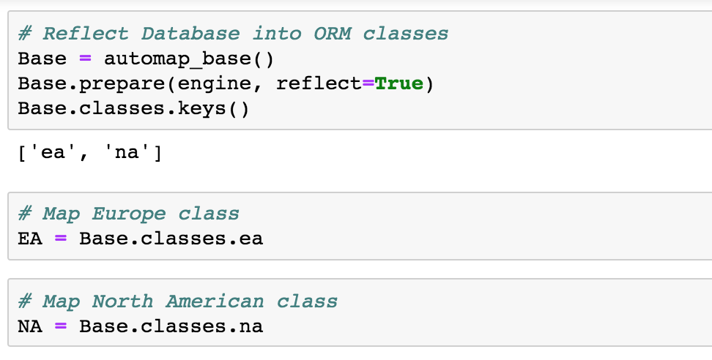
Code Exploration
(01-Ins_Joins /)
The NA (North American mammal) table is queried, and filtered for rows where the genus is Antilocapra
Moving on to joins, we first use inspect to retrieve the names of the tables in the database:
We can inspect to retrieve the names of the columns in a table
Selects for all sporder columns from both EA (Europe) and NA (North America) tables

Slide 4
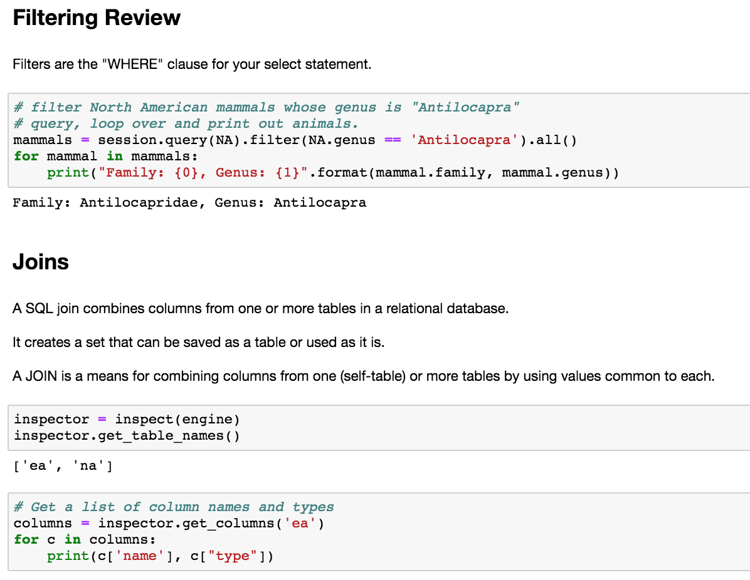
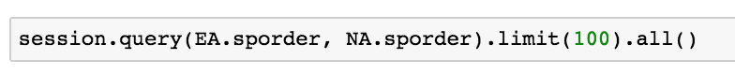
Code Exploration
(01-Ins_Joins /)
This query selects for all sporder
columns from both EA (Europe) and NA (North America) tables:
This performs a cross join, or combines each row in one table with all the rows of the other.
Basic join is a filtering of this result, which we will see in the next cell.
Joining the two tables together
The sel variable is assigned to a list that holds the columns queried from both tables.
Then the results are filtered for rows in each the sporder is the same in both tables.
Finally, the results are packed into a tuple and printed.

Slide 5
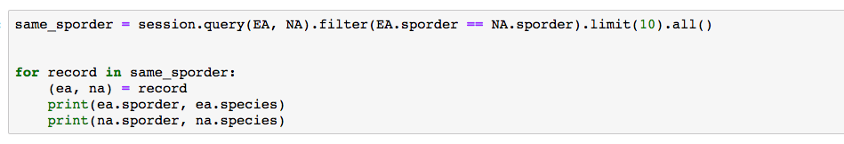
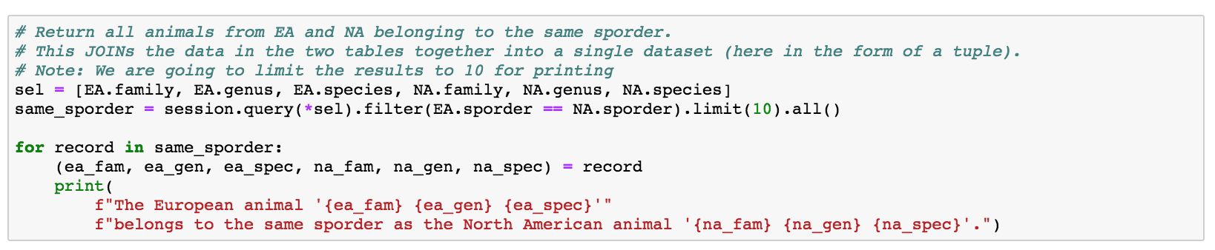
Code Exploration
(01-Ins_Joins /)

Slide 6
Code Exploration
(02-Ins_Dates /)
Dates have traditionally been trickier to manipulate than integers or decimals in programming.
For example, to add and subtract dates might involve doing so in seconds, then converting the results to days, months, weeks, or years.
Python offers libraries that make handling dates easier.
After setting up and reflecting the SQL database into Python objects with SQLAlchemy.
To show the latest date, order the dates in descending order and query the first result.
It is also possible to filter for dates greater than (or less than) a given date:

Slide 7
Code Exploration
(02-Ins_Dates /)
The Python datetime library
date.date or date.datetime can be used to retrieve and format dates and datetimes in ISO format.
Difference in time can also be calculated with timedelta
Difference in time can also be calculated with timedelta

Slide 8
Code Exploration
(02-Ins_Dates /)
It's possible to query a date using the datetime library, then use the results in a SQLAlchemy filter
DATETIME OBJECT
Extracting a specific parameter, such as date, week, or hour, from a datetime object
SQLAlchemy's func.strftime method
Query for all dates matching the
following date string in the format `%d`

Slide 9
Partner Do (Together)
(03-Stu_Dates – 15 min) Instructions
Use the dow.sqlite dataset provided to analyze the average stock prices (average open, average high, average low, average close) for all stocks in the Month of May
Plot the results as a Pandas or Matplotlib Bar Chart
Bonus
Calculate the high-low peak-to-peak (PTP) values for `IBM` stock after `2011-05-31`.
Note: high-low PTP is calculated using `high_price` - `low_price`
Use a DateTime.date object in the query filter
Use a list comprehension or NumPy's ravel method to unpack the query's list of tuples into a list of PTP values.
Use matplotlib to plot the PTP values as a boxplot

Slide 10
Review
(03-Stu_Date)
AVERAGES
The first task was to obtain the average price of each stock during the month of May.
SQLAlchemy's func.avg method is used to obtain the average prices of opening, high, low, and closing prices.
AVERAGES QUERIED
These averages are queried, then filtered for results from the month of May.
func.strftime is used to filter for results from May.
%m specifies the month.
May average prices are pulled into a pandas data frame, then plotted with Matplotlib:

Slide 11
Review
(03-Stu_Date)
BONUS
Subtract, from IBM's high price after May, 2011, its low price.
The datetime library is used to assign a date to a variable.
It is then plugged into the SQLAlchemy query to filter out dates that come after May 31, 2011.
Datetime library.

Slide 12
The Modern Web, APIs, Applications, & JS Libraries

Slide 13
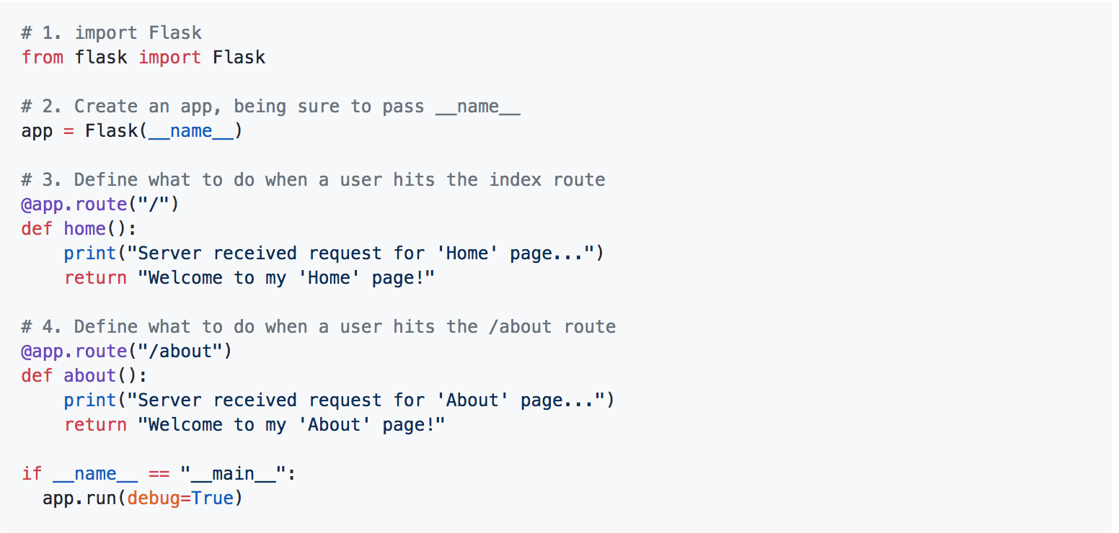
Code Exploration
(04-Ins_First_Steps_with_Flask /)

Slide 14
Students Do (Solo)
(05-Stu_Hello_Web – 10 min) Instructions
Take a moment to run Activities/05-Stu_Hello_Web/Solved/app.py, and open it in the browser at localhost:5000. Demonstrate each of the below endpoints:
/
/about
/contact
NOTE: Each of these endpoints simply returns a string.

Slide 15
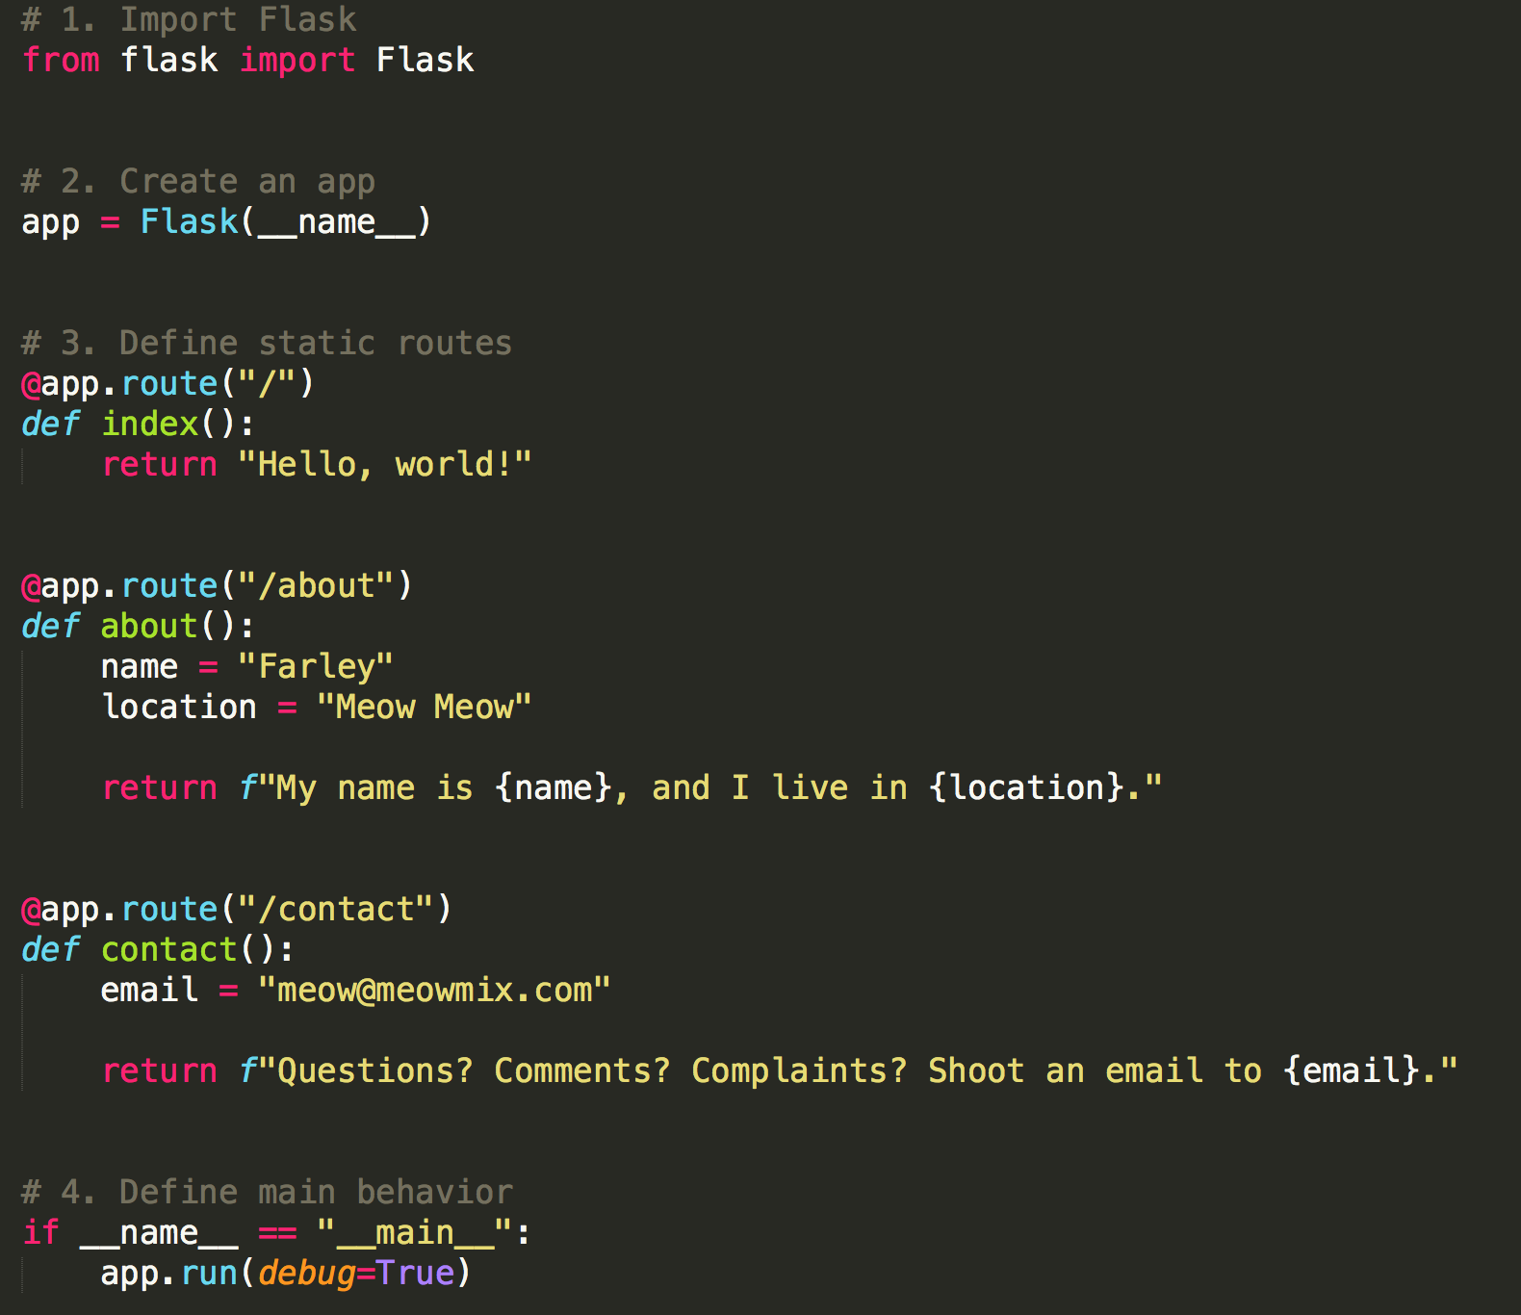
Review
(05-Stu_Hello_Web )
Import Flask
Use Flask to create an app
Use the @app.route decorator to define a route.
@app.route is a function which takes the route's URL as its argument.
We then define a function which describes how the server should respond to requests to the corresponding endpoint.
We can use whatever names we want for these functions, which are often called request handlers.
Define the behavior for when we start the server by running the file from the command line with:
python app.py

Slide 16
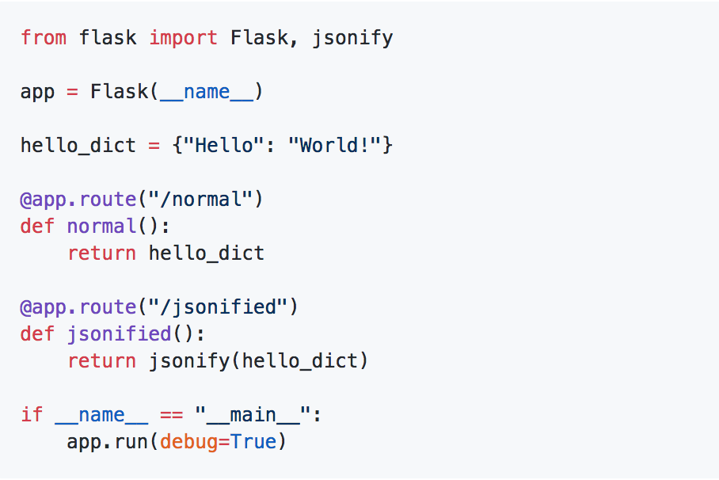
Code Exploration
(06-Ins_Jsonify /)
Import jsonify in addition to Flask.
The /normal route simply returns hello_dict, with no call to jsonify.
We've used return jsonify(<dictionary_name>) to send a JSON response.
Run app.py, and navigate to localhost:5000/normal to demonstrate the error Flask generates.
We've used debug=True to see detailed log output.
NOTE: set debug=False in public-facing projects, otherwise they can easily leak data about their users and application accidentally.

Slide 17
Students Do (solo)
(07-Stu_Justice_League – 20 min) Instructions
Create a **GET** route called `/api/v1.0/justice-league`.
Inside of your GET route, create a function called `justice_league` that will use `jsonify` to convert the dictionary of Justice League members to a JSON object and return that data as a request.
Define a root route `/` that will return the usage statement for your API.

Slide 18
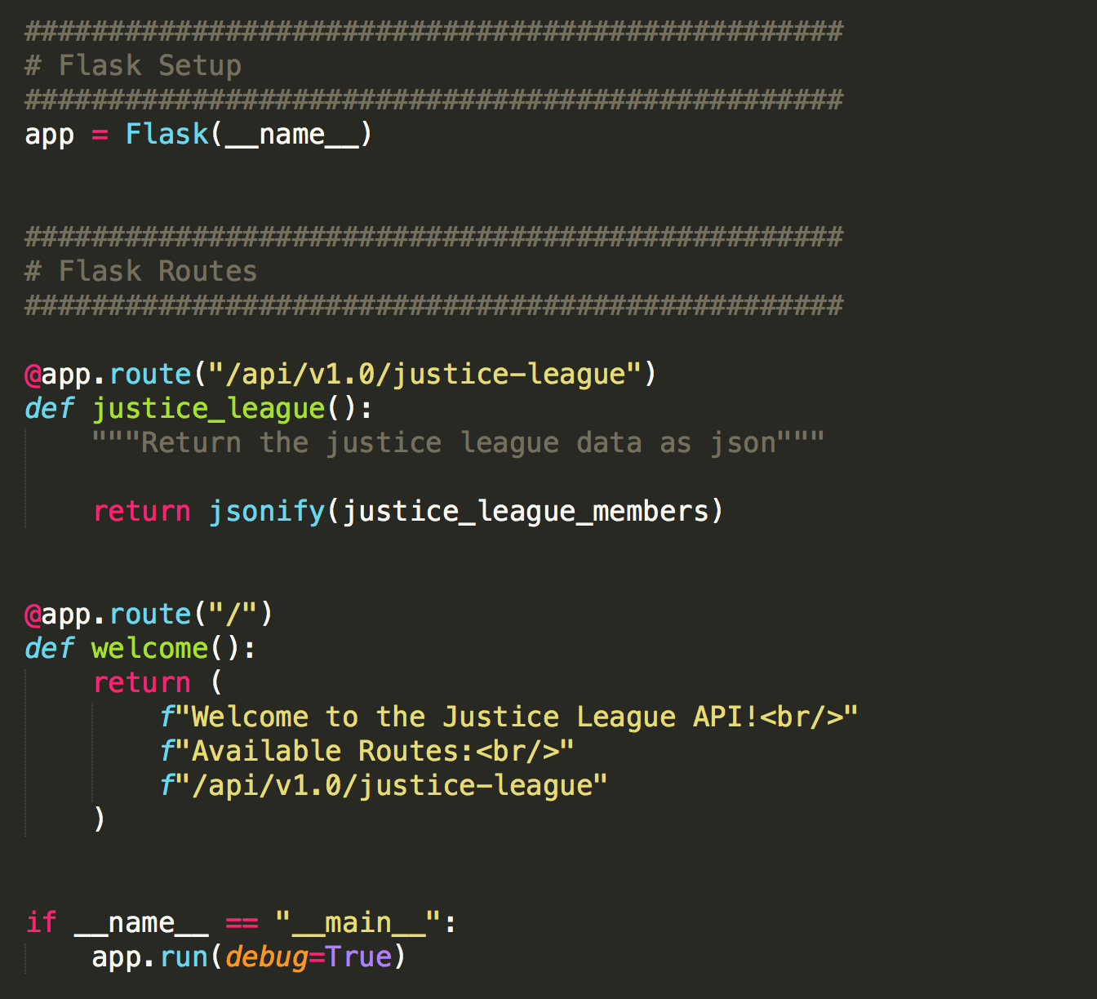
Review
(07-Stu_Justice_League )

Slide 19

Return in 15 Minutes
(~8:00pm)
07-Stu_Justice_League

Slide 20
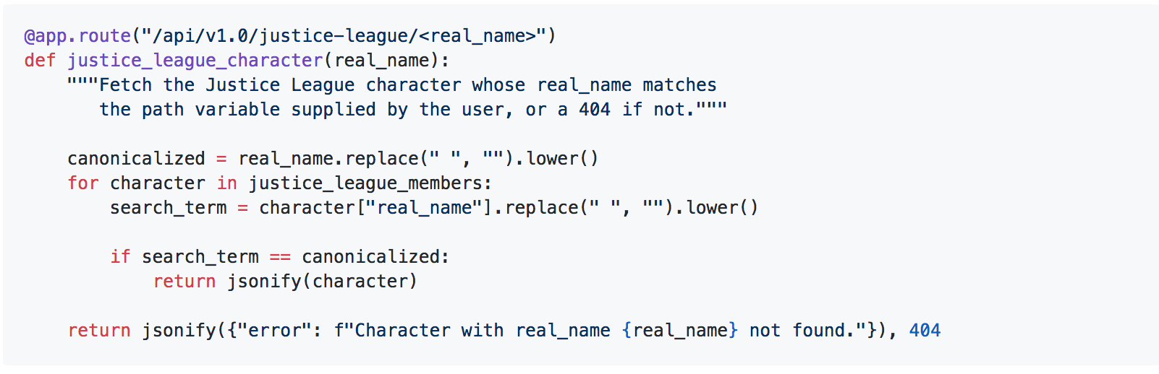
Code Exploration
(08-Ins_Variable_Rule /)
%20 is how we represent the space character within a URL.
Ideally, consumers would be able to specify a character of interest in the URL, and expect either:
A JSON response with the character data, if it's in the data set; or
A JSON response with error information, indicating that the server couldn't find the character the user requested.
/api/v1.0/justice-league
/api/v1.0/justice-league/Arthur%20Curry

Slide 21
Students Do (solo)
(09-Stu_Variable_Rule – 20 min) Instructions
Using the last activity as a starting point, add code to allow for getting a specific hero's information based on their superhero name.

Slide 22
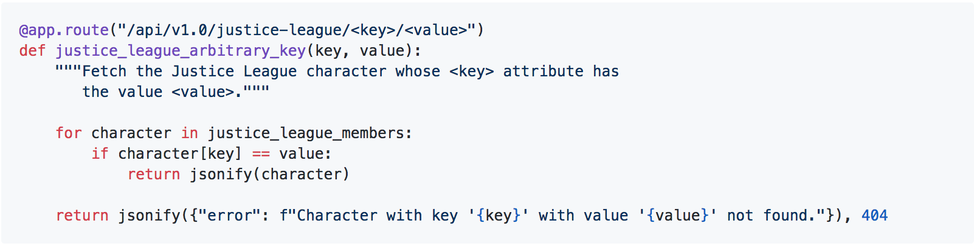
Review
(07-Stu_Justice_League )
Using the last activity as a starting point, add code to allow for getting a specific hero's information based on their superhero name.

Slide 23
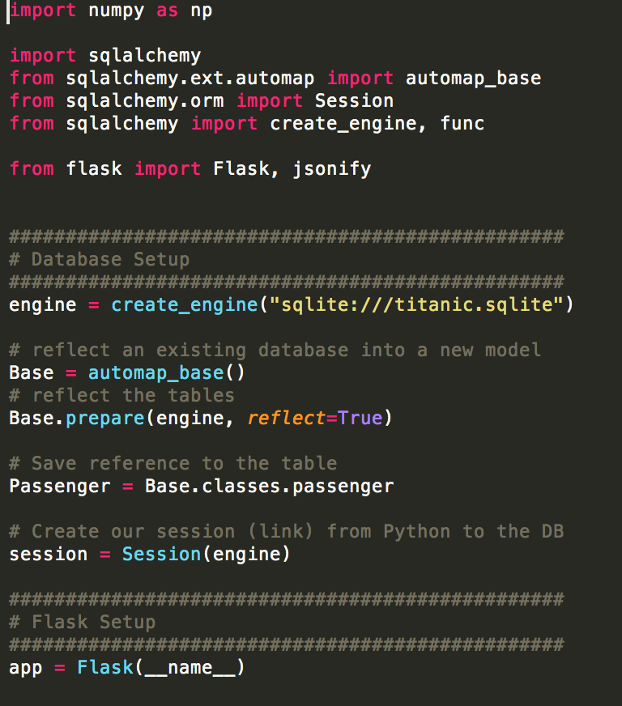
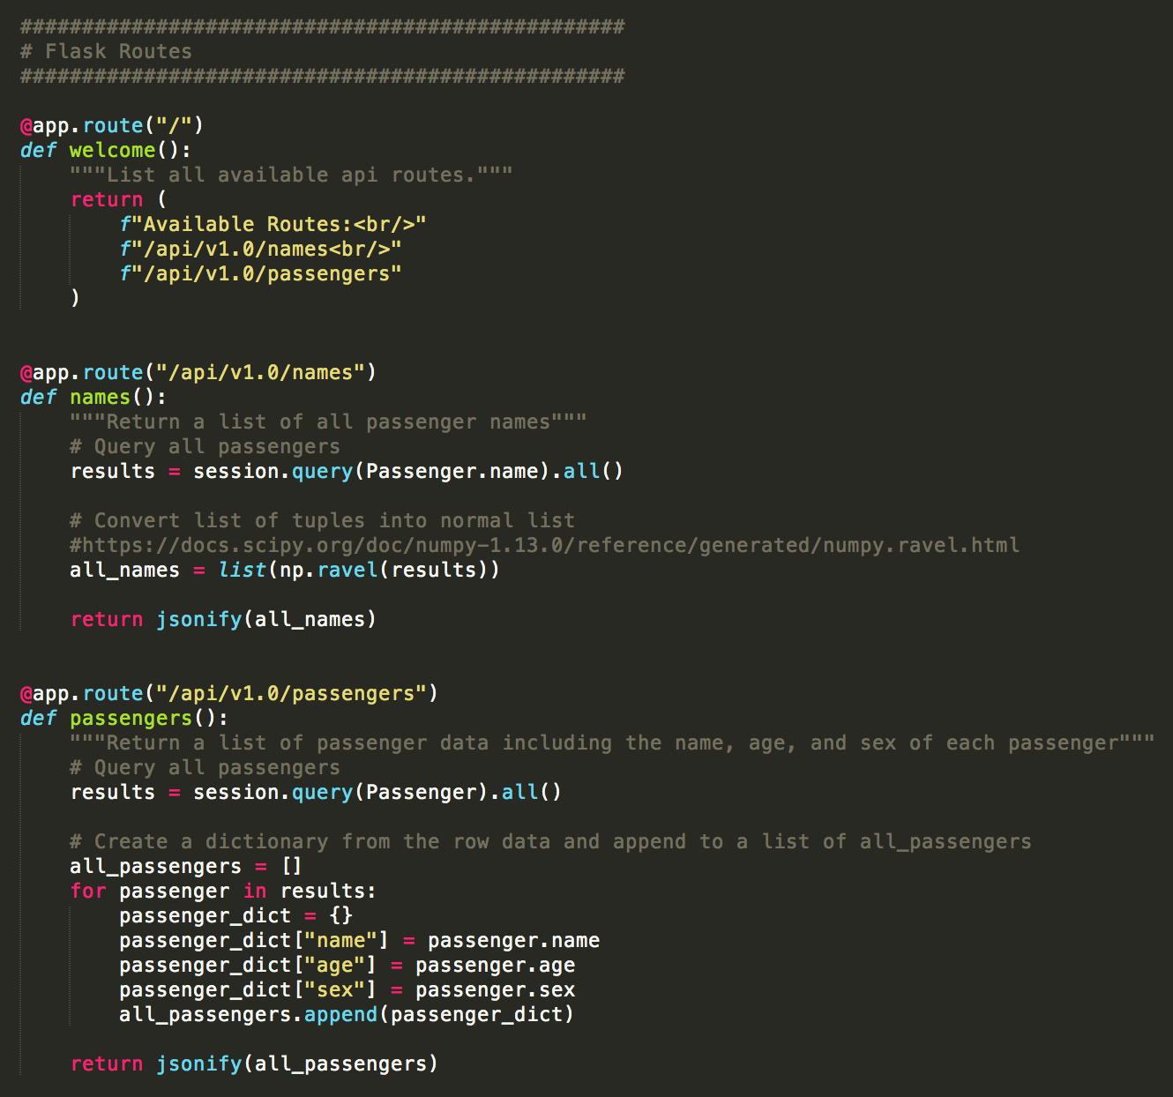
Code Exploration
(08-Ins_Variable_Rule /)

Slide 24
Homework Demo

